Slide 1
Deep Learning CA1
By Raymond Ng - DAAA2B04 - 2123574
Notes:
tch_size

Slide 2
Abstract
To Implement a image classifier using a Deep Learning Network using previous SOTAs (State of the Arts) model architectures as experiments and inspiration to build a Custom Network Architecture from scratch. (Architectures cited from technical papers)
Model Architecture:
VGG-16 and VGG-19, AlexNet, ResNet18, ResNet50, ResNet152
Feature Engineering:
Random Augment, Resizing, Normalizing, Train, val and test loader
Model training methods:
Optimizer, Loss Function, Learning Rate, Learning Rate Scheduler, Weight decay(L2 regularization), Early Stopping, Epochs, Batch_size

Slide 3
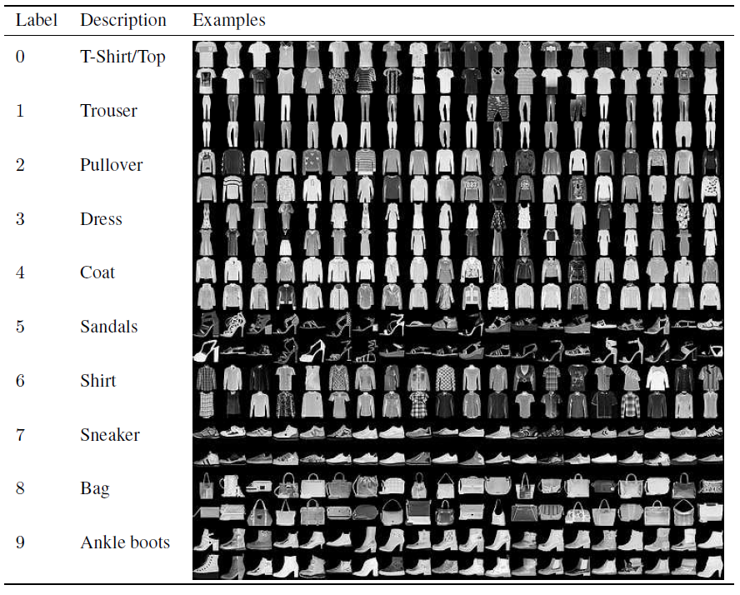
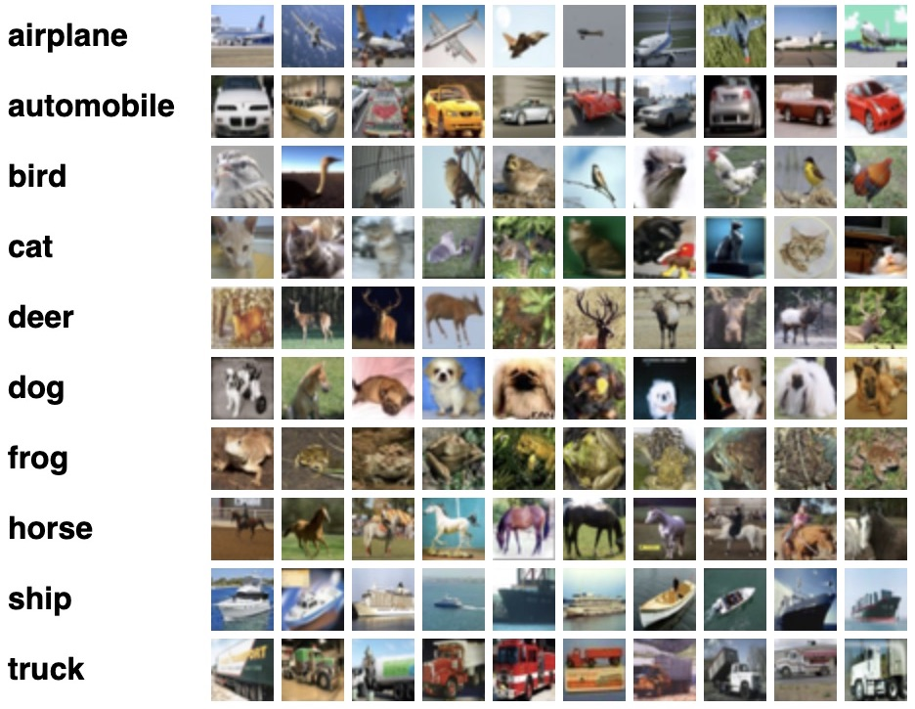
Dataset
Fashion-MNIST
CIFAR-100
Fashion-MNIST is a dataset of Zalando's article images consisting of a training set of 60,000 examples and a test set of 10,000 examples. Each example is a 28x28 grayscale image, associated with a label from 10 classes.
The CIFAR-100 dataset (Canadian Institute for Advanced Research) and consists of 60000 32x32 color images. The 100 classes in the CIFAR-100 are grouped into 20 superclasses. There are 6000 images per class with 5000 training and 1000 testing images per class (not taking into account superclass)

Slide 4
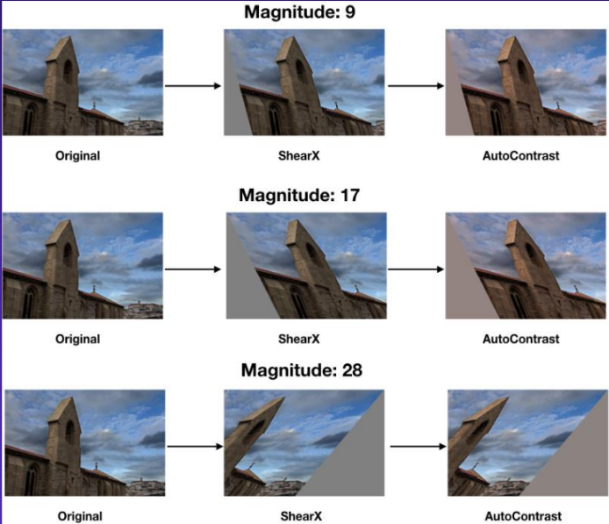
Feature Engineering
Image Augmentation using RandAugment (Cubuk E.D. et al., 2020) to improve generalization of deep learning models to improve validation accuracy. Paper(https://arxiv.org/abs/1909.13719)
Image Augmentation techniques:
Part A: Since its a single channel grey-scale, used edited source code from RandAugment (e.g. Identity, ShearX, ShearY, TranslateX, TranslateY, Rotate, Brightness, Color, COntrast, Sharpness, Posterize, Solarize, Autocontrast, Equalize)
Part B: Since its a RGB 3 channel, default RandomAugment can be used
Notes:
Data augmentation to train the model with augmented images using things like translate or rotate which will improves model accuracy after training with these augmented images

Slide 5
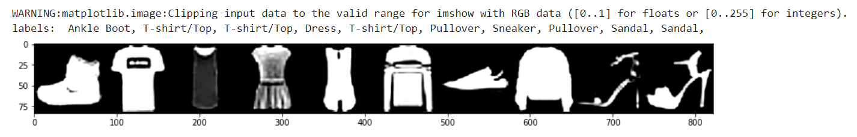
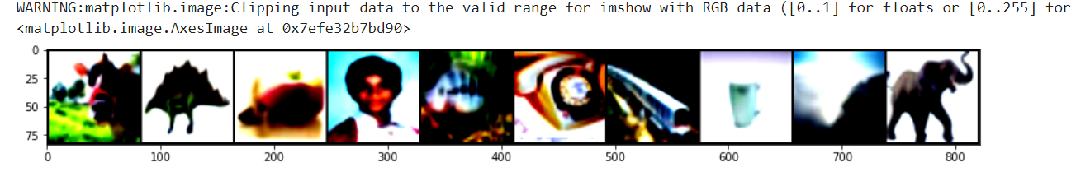
Feature Engineering
Random Horizontal flip - flip the given image randomly
RandomCrop - Crop the image at a random location
Resize - constant 80*80 sizing for ease of model architectures
Normalizing using means and standard deviation to standardize pixel values of image, mean and std calculated from train_data
Set batch size 96 for A, 32 for B
Notes:
If you look carefully you can see some images that are copped or flipped, this is the effects of RandAugment

Slide 6
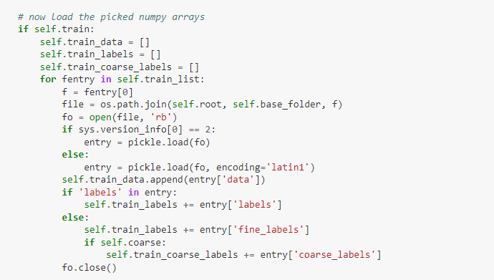
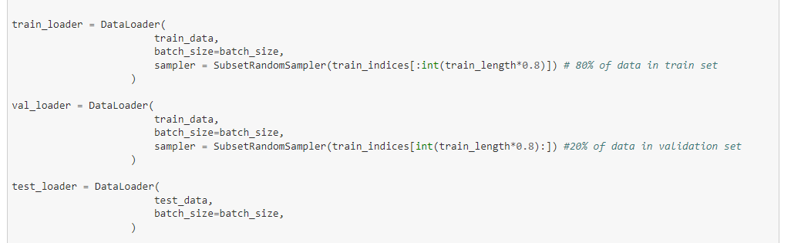
Feature Engineering
For Part B, because its pytorch, two classes Cifar-10 and Cifar-100 were used to extract the fine and course labels
Data is then grouped into 3 loaders for pytorch
Notes:
Fine is for 100, course is for 20

Slide 7
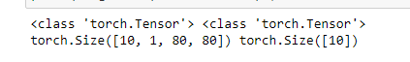
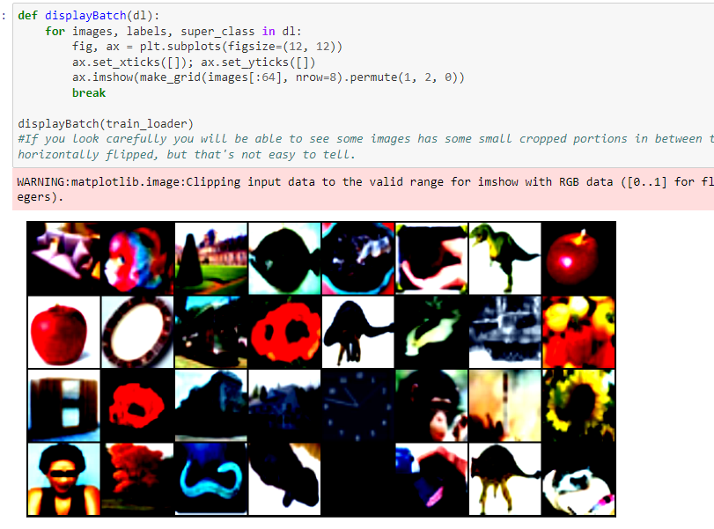
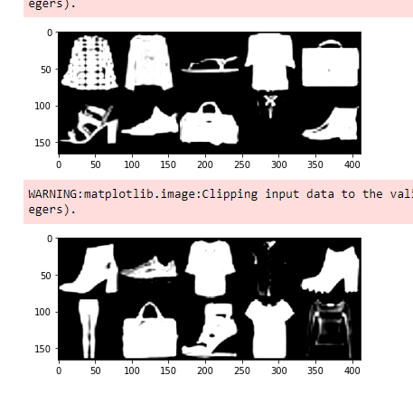
EDA
Notes:
For EDA, i did some basic eda of the images, some with labels like for MNIST, but mainly its to see the effect of augmentation and also the tensor shapes we are inputting into our models and mainly get a better understanding of the data

Slide 8
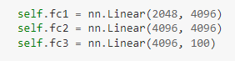
Defining Modeling - CNN
Convolution Layers
This layer is the first layer used to extract various features from input images, for example a filter of size MxM determined by kernel size and stride will slide over the image and the dot product is taken between the filter and parts of the image with respect to size of filter
Pooling Layers (Used Max and Avg pooling)
For most of my models, a convolutional layer is followed by a pooling layer, the aim is to decrease the size of the convolved feature map to reduce computational costs. This is done by summarising the features, for example a max pooling 2d with kernel size of 2 will take input image of 128 * 128 and return 64 * 64, I usually used Max pooling and avg pooling and the difference is that for max pooling largest element is taken, while for avg pooling it takes the average of elements.
Fully Connected Layers
Fully connected layer consists of weights and biases along with neurons and is used to connect neurons between two different layers. These are usually flattened and placed before the output layers to form the last few layers. This is where the classification will take place alot of architectures such as VGG and AlexNet used 3 fully connected layers at the end which improves performance by learning more features

Slide 9
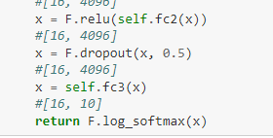
Defining Modeling - CNN
Dropout (reduce overfitting)
Usually when all features are connected to FC layer, it can cause overfitting in training dataset. To overcome this problem, a dropout layer is utilised wherein a few neurons are dropped from the neural network during the training process resulting in a smaller sized model. For example my dropout of 0.5 here randomly drops out 30% of nodes
Activation Functions
Activation functions are used to decide which information of the model should fire in the forward direction and which shouldn’t make it to the end of the network. It adds non-linearity to the network. Several common ones I used are are ReLU and Softmax because its for classification models. It decides whether input is important or not to predict using mathematical operations

Slide 10
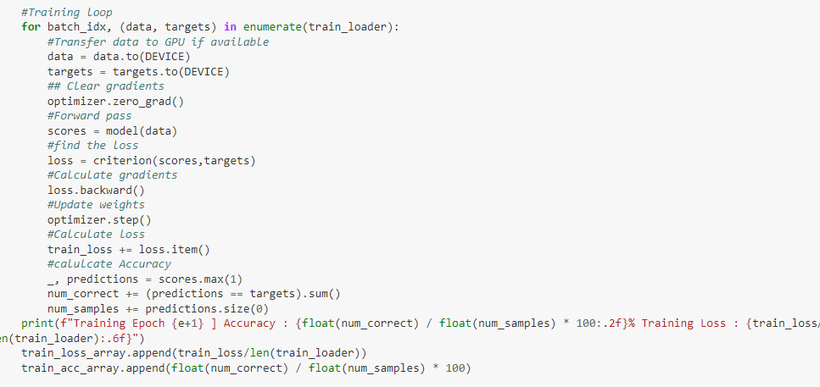
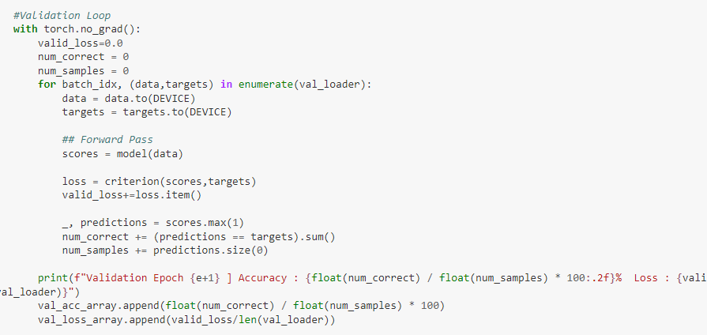
Model Training
Training Loop
Validation Loop
Notes:
Training consists of iterating and processing the images in batches, inside each batch, we will import labels and features, reset the optimizer and push the data forward through the layers of the model, this is called forward pass. We will calculate the loss and back propagate by making the optimizer go back update the weights. We will then calculate the average loss and accuracy of the entire epoch with its many steps.
For validation loop we need the model in evaluation mode and note we do not back propagate here since this is validation. We will process it in batches again, iterate over batches and predict for each image in the batch. Calculate the loss and accuracies for this to evaluate the model. These two loops are necessary to see the trends between training and validation and ensure there is no overfitting.

Slide 11
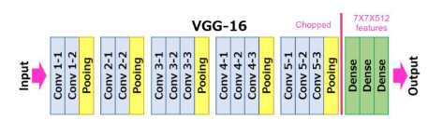
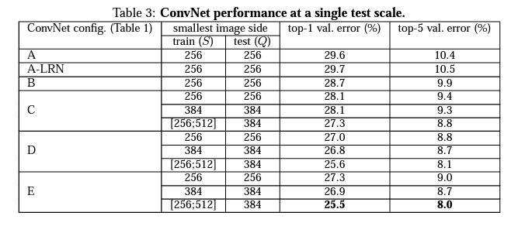
Modeling Experiments - VGG
VGG stands for Visual Geometry group, SOTA in 2014 for ILSVRC
I used the VGG Conv Net architecture of 16 Layers and 19 Layers to experiment, model D and E from technical paper (https://arxiv.org/pdf/1409.1556.pdf)

Slide 12
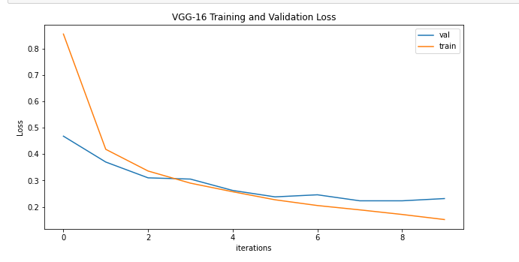
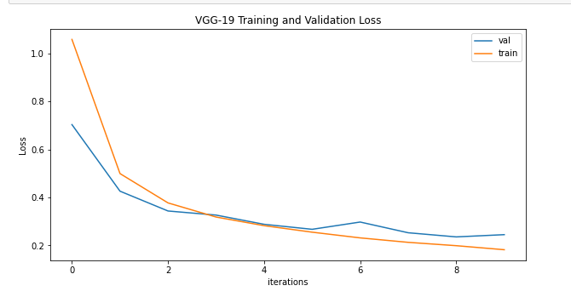
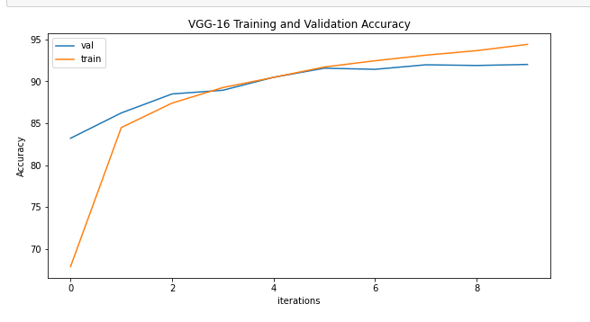
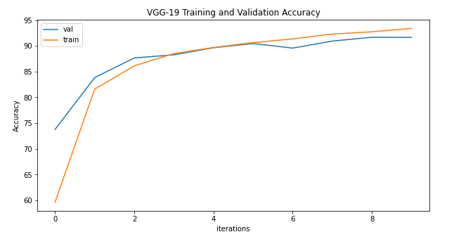
Modeling Experiments - VGG - Part A
VGG-16
VGG-19
Notes:
VGG performed quite well for Part A with good trends for both loss and accuracy curves, VGG-16 and 19 are similar in performance with VGG-16 achieving 91.43% and VGG-19 achieving 91.11% so i chose VGG-16 because it is more efficient with VGG-16 taking 20 mins and VGG-19 taking 24 mins, this was also the case stated in the technical paper, where they said vgg-19 although had a very slight increase in performance compared to vgg-16 which can probably be seen if epochs were more than 10, vgg-16 is still preferred for efficiency. For the trends for the loss curve both converges very well with a nice downwards trend for both 16 and 19, while for accuracy plots they both converge nicely as well with a nice upwards trend, there is no signs of overfitting.

Slide 13
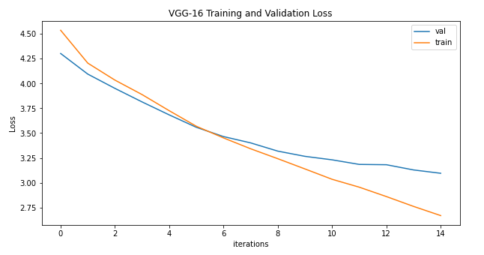
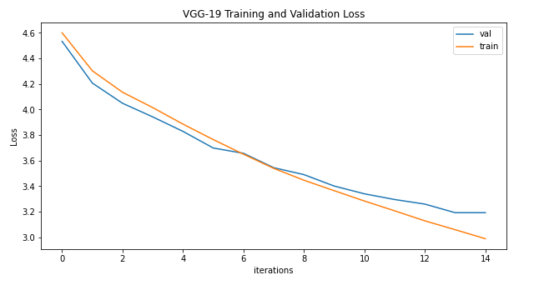
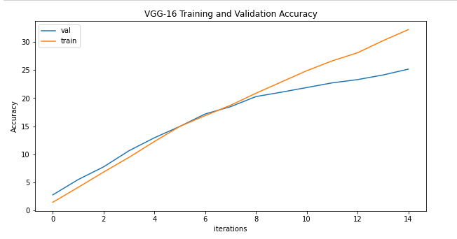
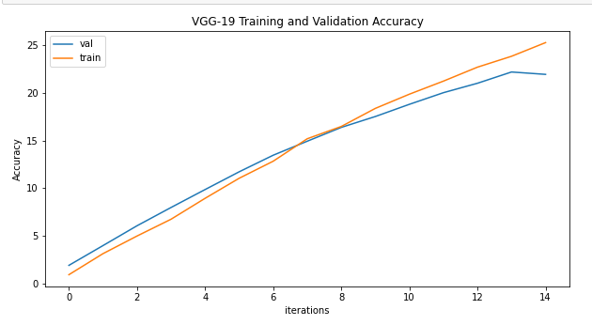
Modeling Experiments - VGG - Part B
VGG-16
VGG-19
Notes:
VGG performed poorly in Part B being the worst out of all architecutres, VGG-16 and 19 are similar in performance with VGG-16 achieving 26.28% and VGG-19 achieving 22.72%, As for training times, VGG-16 took 40 minutes, while VGG-19 took 48 minutes, once again VGG-16 has been proven to be more efficient with a small difference in accuracy. VGG-19 did not perform better than 16 likely due to small number of epochs but due to time constraints that experiment will not be done. FOr trends as you can see on the left, VGG-16 starts to show large signs of overfitting at the 10th epoch onwards while vgg-19 did not show that. Overall the trend direction is good however, due to low accuracy scores and the potential of overfitting as the epochs get larger, VGG will not be used for Part B

Slide 14
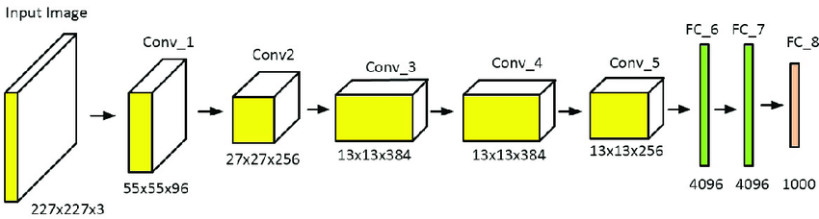
Modeling Experiments - AlexNet
AlexNet by (Alex Krizhevsky) one of the first famous architectures and SOTA in 2012 for ILSVRC paper
(https://proceedings.neurips.cc/paper/2012/file/c399862d3b9d6b76c8436e924a68c45b-Paper.pdf)
AlexNet contains 8 layers, first 5 being convolutional, followed by max-pooling layers and 3 fully connected layers, it used non-saturating ReLU activations function instead of tanh for non-linearity and used Avg pooling as well, dropout instead of regularization for overfitting
Notes:
AlexNet performed decent trendwise for both part A and B however it did not have the best loss values and highest accuracy values.

Slide 15
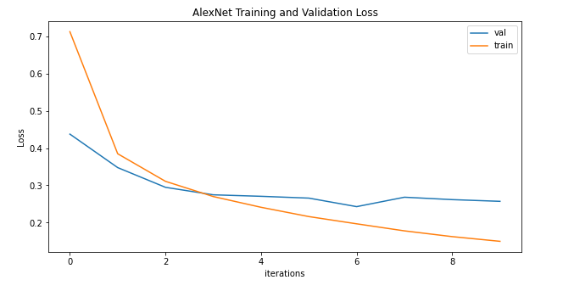
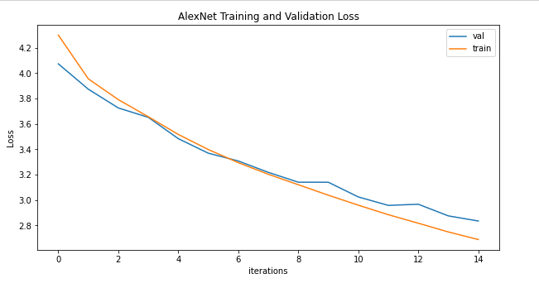
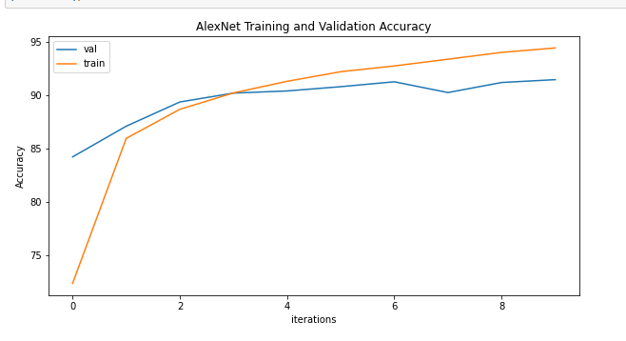
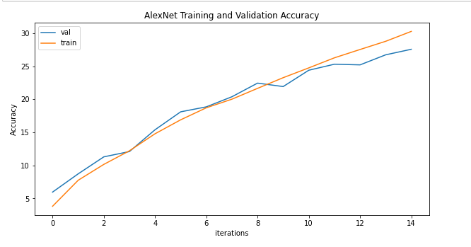
Modeling Experiments - AlexNet - Comparison
Part A
Part B
Notes:
AlexNet performed the average out of all models for both Part A and Part B, this is likely because it is the least advanced one in 2012. AlexNet achieved a accuracy of 91.07% in part A and a accuracy of 27.75% in Part B. As you can see for Part A and B the loss curves and accuracy curves all have a nice trend, it converges after awhile and shows small signs of overfitting, however compared to VGG-16 in Part A with a accuracy of 91.43% and ResNet18 in Part B with accuracy of 42.96%, AlexNet was not selected as the final model for either Part A nor B

Slide 16
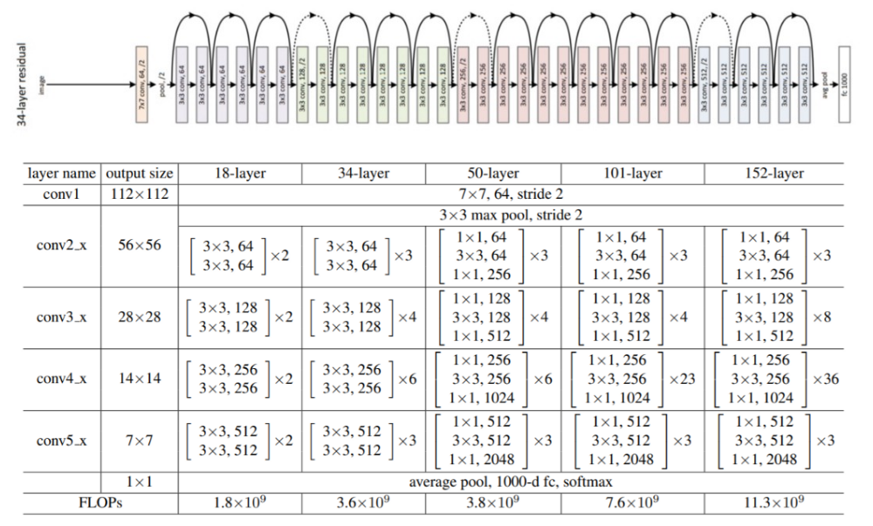
Modeling Experiments - ResNet
ResNet was SOTA in 2015 ILSVRC, paper (https://arxiv.org/abs/1512.03385v1)
ResNet became popular because it avoids the vanishing gradient problem, this solution was crafted by using residuals, from the previous layer, added to the output of current layer
Notes:
ResNet performed poorly for Part A for both loss trends and accuracy trends. ResNet 152 although did perform better than ResNet 18, with low accuracy, it was still not a suitable architecture for the Part A fashion mnist dataset
For Part B
ResNet performed very well for all 18 50 and 152 for Part B with only 15 epochs, it showed the best trends out of all architectures with no signs of overfitting and only exception is ResNet 18 had the best accuracy with the least training time, so i will be making my custom model for Part B based on ResNet

Slide 17
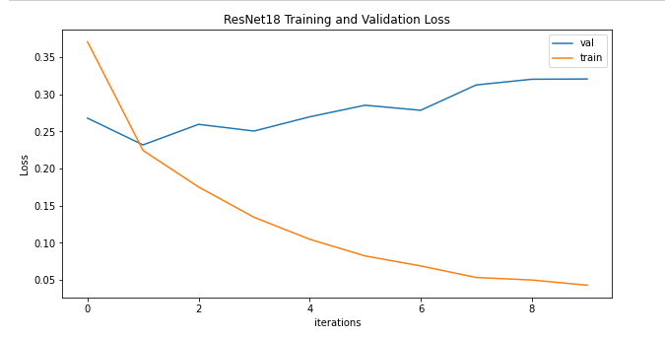
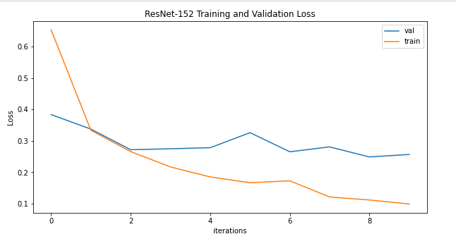
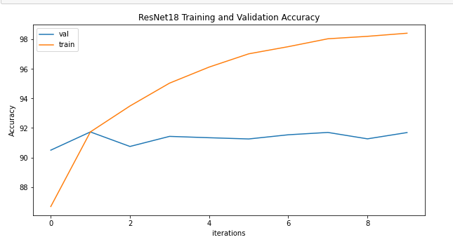
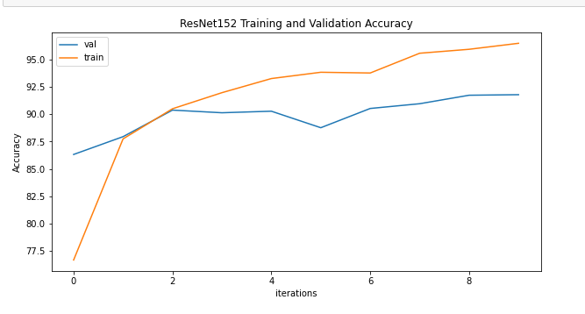
Modeling Experiments - ResNet - Part A
ResNet-18
ResNet-152
Notes:
ResNet performed poorly for Part A for both loss trends and accuracy trends. ResNet 152 although did perform better than ResNet 18, with low accuracy, it was still not a suitable architecture for the Part A fashion mnist dataset. As you can see for ResNet 18 on the left, it achieved an accuracy of 91.21% but the trends for the loss curve are going upwards and the accuracy curve is not showing any downwards trend. Thus ResNet18 can be considered the worse choice for Part A, for ResNet152, the accuracy 91.22% so it shows not much improvement in accuracy despite much longer training times, however loss curve and accuracy curves does show a trend despite it being overfitting.

Slide 18
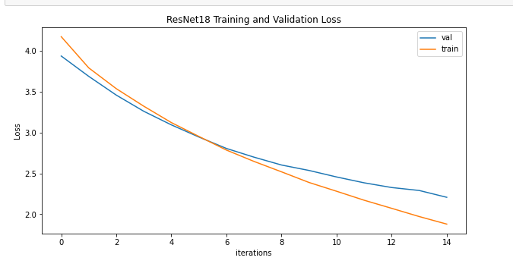
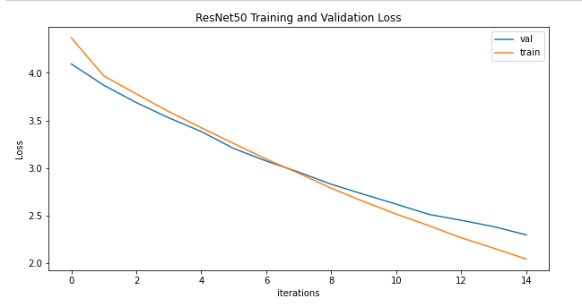
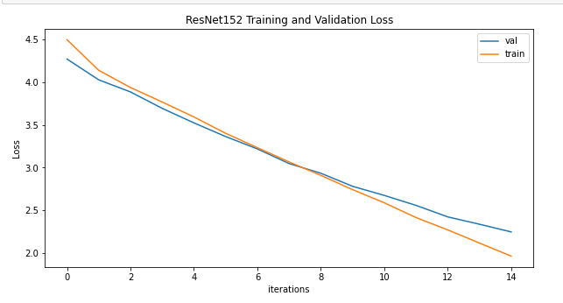
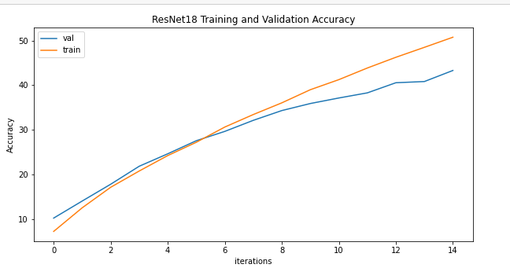
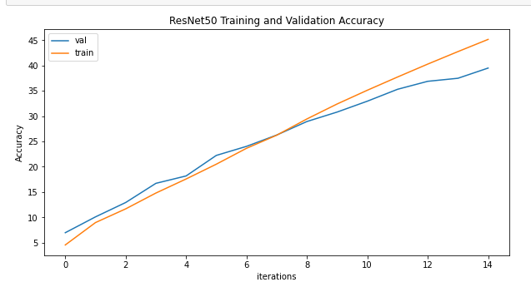
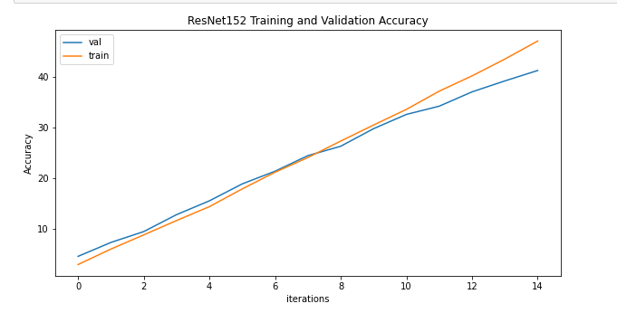
Modeling Experiments - ResNet - Part B
ResNet-18
ResNet-50
ResNet-152
Notes:
For Part B
As you can see all 3 architecture layers performed well with the accuracies of 43%, 39% and 41% respectively, however ResNet 18 had the best accuracy and also the smallest losses at 2.21 validation loss. The training times were 1 hr, 2.5hr and 5.5hr respectively so ResNet 18 was also the most efficient.
ResNet performed very well for all 18 50 and 152 for Part B with only 15 epochs, it showed the best trends out of all architectures with no signs of overfitting and only exception is ResNet 18 had the best accuracy with the least training time, so i will be making my custom model for Part B based on ResNet.

Slide 19
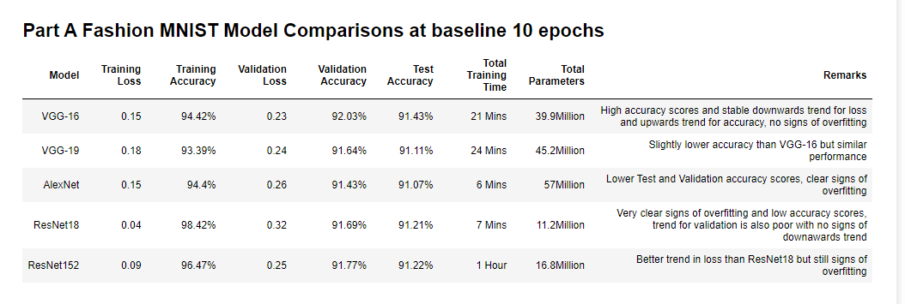
Model Comparisons - Part A
Notes:
For Part A, the best model was VGG-16 as u can see the best test accuracy was VGG-16, the ResNet had better training performance however this was shown to be large signs of overfitting, The VGG-16 has… remarks so for Part A the customized model will be VGG-16 inspired

Slide 20
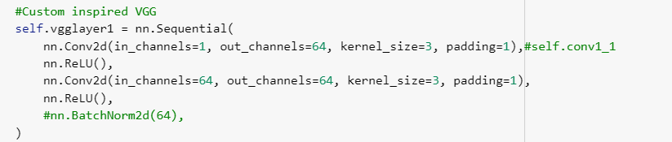
Custom Model Architecture Part A
My Custom model was inspired by VGG architecture so i used 5 vgg layers, after each layer i applied a 2dmax pooling, I did this until layer 4 and 5 where i included batchnorm2d in the 4tha and 5th layers, Avg pooling of (6,6) was done at the end inspired by AlexNet, and 3 fully connected layers at the end like VGG
For Experimental tweaks:
Reduced the amount of layers to reduce model complexity since this is a simple dataset
Added Batch normalization since it has a regularizing effect on CNN by normalizing inputs to layers deeper into a network
I did global pooling average inspired by alexnet to reduce overfitting
More dropout before classification to reduce overfitting
L2 regularization with weight decay to prevent overfitting

Slide 21
Hyper-parameters
Hyper-parameter tweaks:
Learning Rate of 1e-2 to 1e-5
Weight decay of 1e-3 to 1e-5
Learning Rate scheduler between multiplicativeLR, StepLR, MultiStepLR, ReduceLROnPLateu
Loss Function between Cross Entropy and NLLoss for classification
Optimizer between Adam and SGD, SGD provided smoother and more stable learning curves
Notes:
Optimizer between Adam and SGD

Slide 22
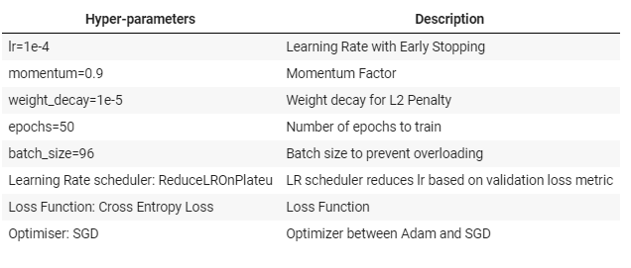
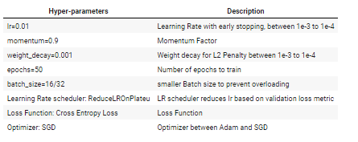
Hyper-parameters
Part A
Part B
Notes:
Experiments for Hyperparameters:
Learning rate of (1e-3 to 1e-5)
Weight decay of (1e-3 to 1e-5)
Learning Rate Scheduler between LambdaLR, multiplicativeLR, StepLR, MultiStepLR, ReduceLROnPlateu
Loss Function between CrossEntropy and NLLoss
Optimizer between Adam and SGD
Optimizer between Adam and SGD

Slide 23
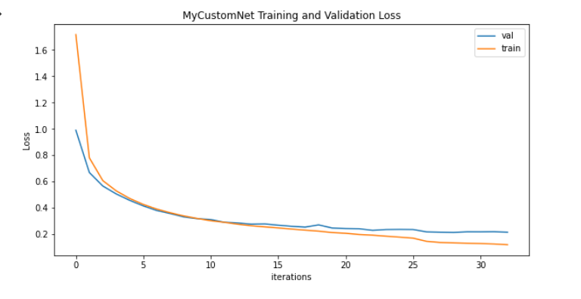
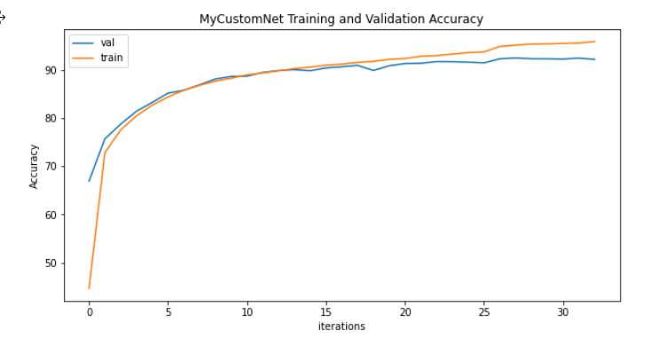
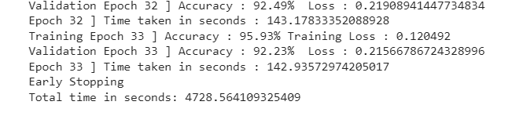
Custom Model Architecture Part A - Evaluation
CustomVGGNet has a good trend for both loss and accuracy curves, showing no signs of overfitting. Our training accuracy stopped at 95.93% with 0.12 loss and Validation accuracy stopped at 92.23% with 0.21 loss. Total time spent training was 78 minutes. Final Custom Net showed better results than the VGG-16 which shows that this experiment was a success,

Slide 24
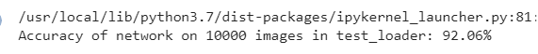
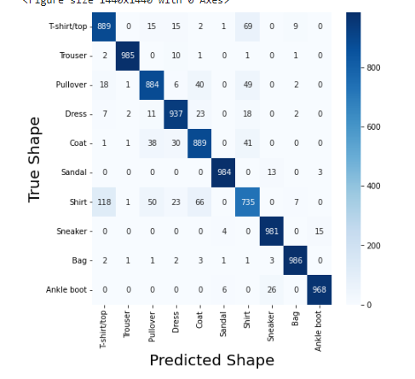
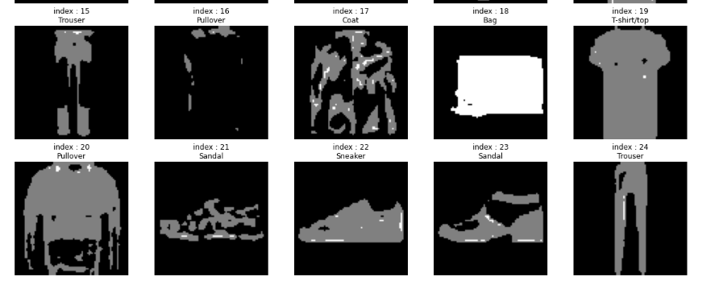
Custom Model Architecture Part A - Evaluation
Final Test accuracy reached 92%, as you can see majority of images are correctly classified by labels, exceptions include index 21 where it is a shoe instead of a sandal also seen in the classification matrix

Slide 25

Model Comparisons - Part B
Notes:
FOr Part B, the best model was ResNet 18, with the best training and validation accuracy, it also had the highest test accuracy and was more efficient in training time compared to the other resnet layers, resmet18 has …. So for Part B the customized model will be ResNet18 inspired

Slide 26

Custom Model Architecture Part B
My Custom model was inspired by ResNet architecture, ResNet 18 was the best showing that perhaps for this dataset, less layers could perform better. I experimented with a ResNet 9 architecture with elements of Avg pooling without any batch norm
For Experimental tweaks:
Reduced the amount of layers to reduce model complexity since this is a simple dataset
I did global pooling average inspired by alexnet to reduce overfitting
L2 regularization with weight decay to prevent overfitting

Slide 27



Custom Model Architecture Part B - Evaluation
CustomResNet has a good trend for both loss and accuracy curves, however it did show signs of overfitting. Our training accuracy stopped at 99.98% with 0.01 loss and Validation accuracy stopped at 68.26% with 1.19 loss. Total time spent training was 105 minutes. Final Custom ResNet showed better results than the ResNet18 which shows that this experiment was a success,

Slide 28



Custom Model Architecture Part B - Evaluation
CustomResNet on 20 superclasses has a similar trend for both loss and accuracy curves, however it did show signs of overfitting. Our training accuracy stopped at 99.99% with 0.008 loss and Validation accuracy stopped at 75.66% with 0.8 loss. Total time spent training was 92 minutes. The same architecture on the 20 superclasses performed an increase in 8% from 68.26% to 75.66%, the loss values were also lower.

Slide 29



Custom Model Architecture Part B - Evaluation
Final Test accuracy reached 68% for the Cifar-100 and 75.51% on the 20 super-classes, as you can see majority of images are correctly classified by labels. And the model improved when only predicting for 20 super classes.

Slide 30
Conclusion
By Raymond Ng - DAAA2B04 - 2123574
Notes:
Conclusion,Both my models achieved a good level of performance and I did most of my code in Pytorch because Pytorch was more catered to the academics and most of my research on other SOTA architectures are also taken from technical papers. For my reflection, I managed to learn pytorch to a good extent due to this project and this project required alot of time, planning and technical skill to research and experimentation to find how i can improve my own custom model. my personal belief is that Pytorch is more difficult than keras and also has less resources than keras. However it has its pros and cons which says that pytorch allows for more details in the modeling so it’ll be better in the long run. For both my models i believe with more training time and computational efficiencies i can increase accuracy levels and decrease overfitting, however i already spent a total of 14 hrs and 7 hrs training for Part A and B respectively not to mention the many hours of retraining and experimentation created 20 gmails and spent 15 dollars on collab. I also managed to allocate my time well and complete a technical paper detailing my process of a CNN on the natural images dataset where i repeated alot of the same things here.tch_size

